Slide 1






AlphaFold training session
Jasper Zuallaert
Kenneth Verstraete
Alexander Botzki

Slide 2
Session outline: what to expect today
Introduction to AlphaFold
AlphaFold availability
Interpreting the outputs
Use-cases and pitfalls
Hands-on: How to run your own AlphaFold experiment on the HPC
Hands-on: a series of example outputs and how to interpret them
Hands-on: Bring your own problem
https://elearning.bits.vib.be/courses/alphafold/

Slide 3
AlphaFold introduction

Slide 4

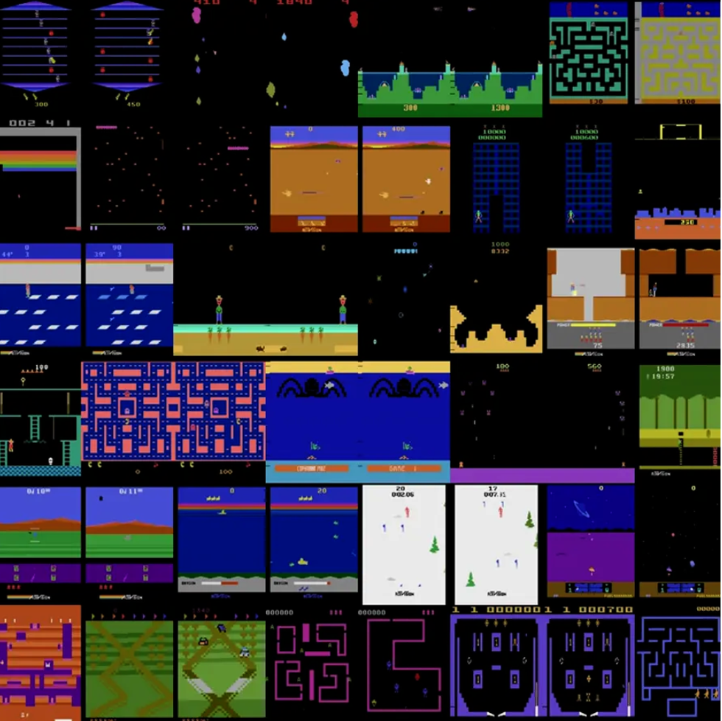
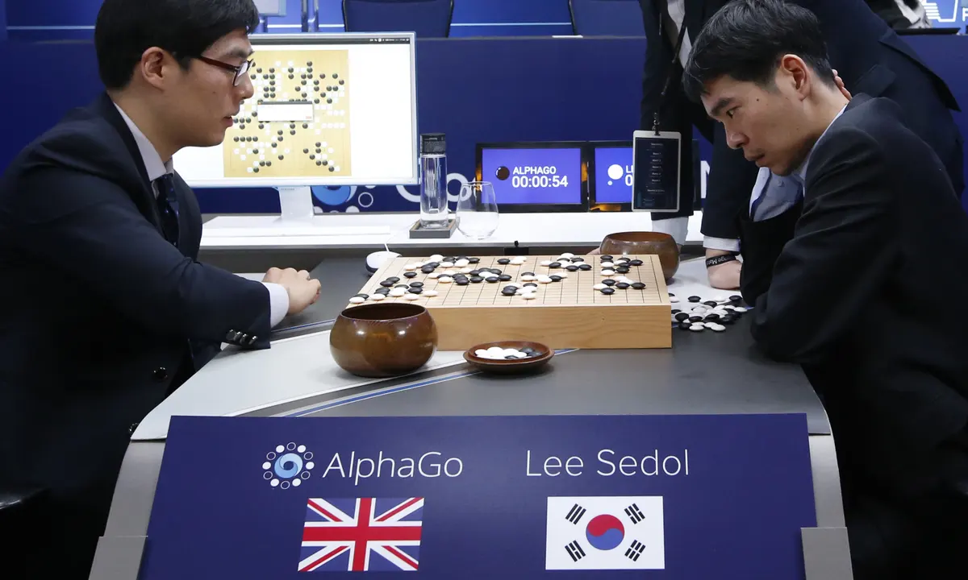
DeepMind: a timeline
2014
2015
2016
2017
2018
2019
2020
Founded in 2010
AlphaZero beats AlphaGo (100-0) and self-teaches chess/shogi
AlphaFold (2.0) wins CASP14
Acquired by Google for $500M
AlphaFold (1.0) wins CASP13
AlphaGo beats Lee Sedol (4-1)
Agent57 surpasses human level performance on all Atari2600 suite games

Slide 5
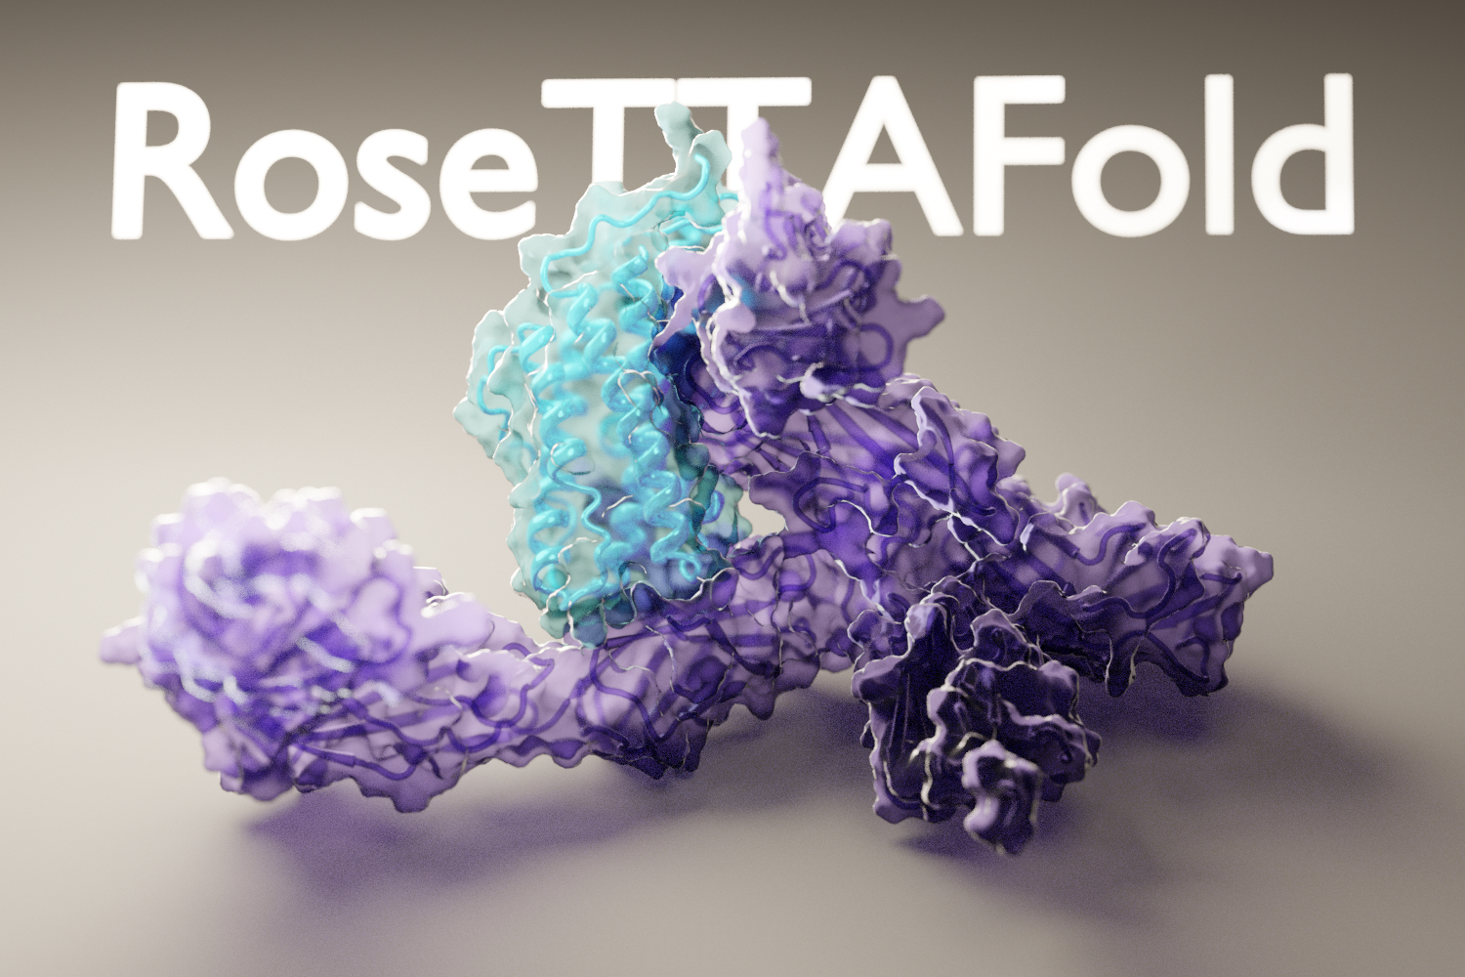
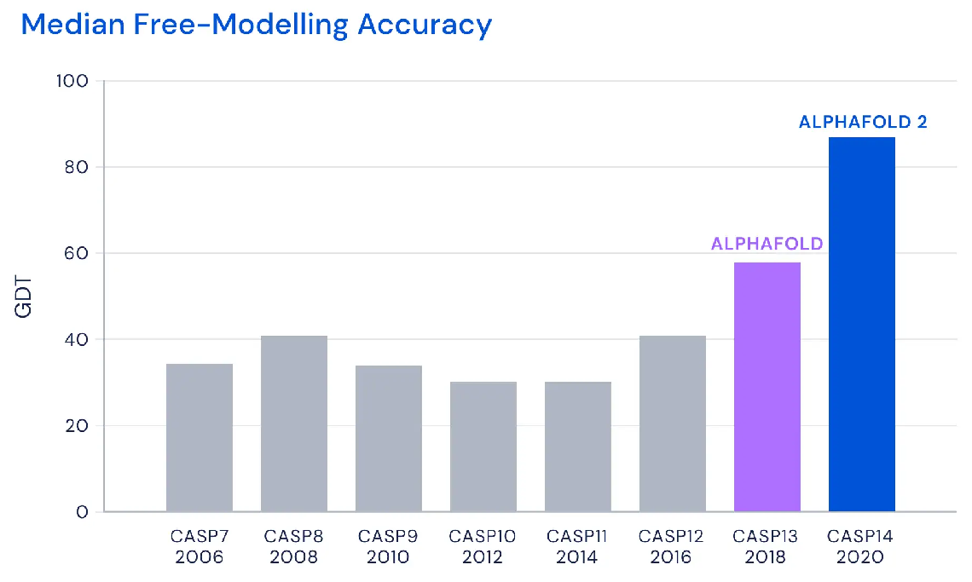
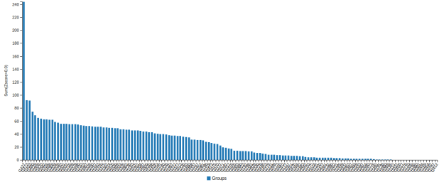
Critical Assessment of Structure Prediction (CASP14, 2020)
AlphaFold2
+ ideas from
Baker lab
CASP14, performance over all targets
Median of 92.4 across all targets, 87.0 in free-modelling accuracy

Slide 6
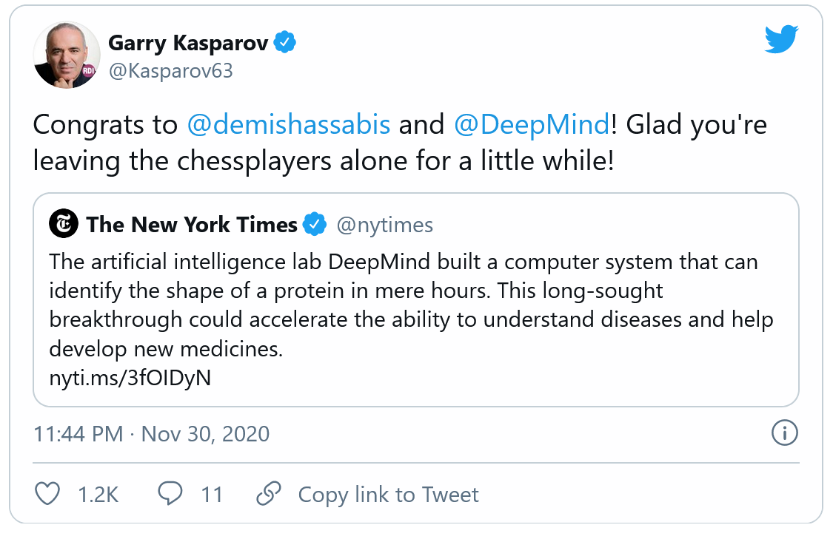

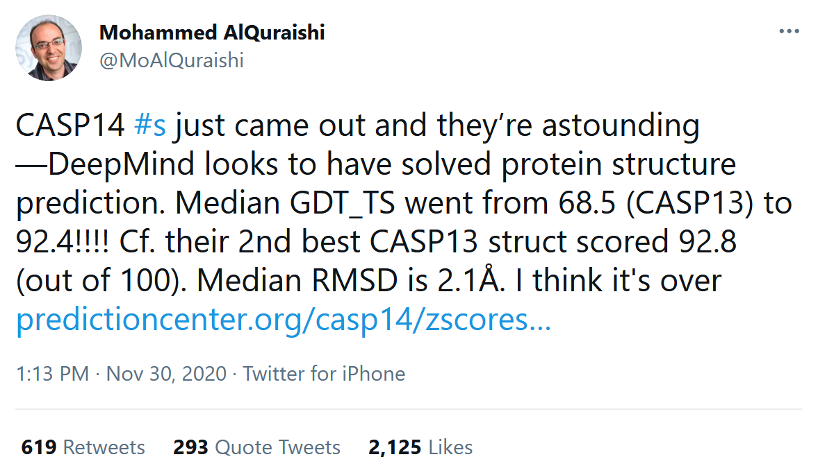
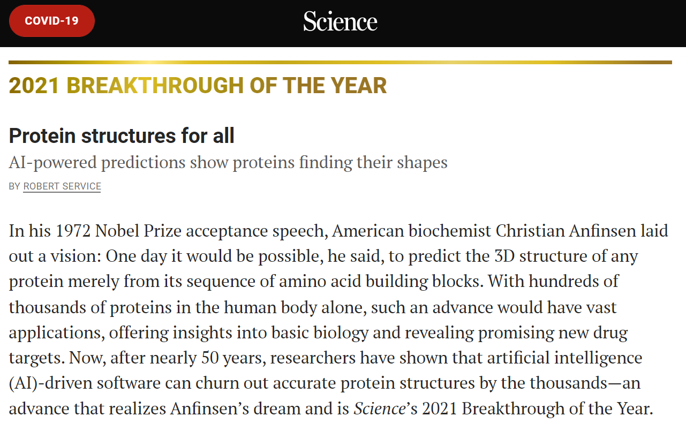
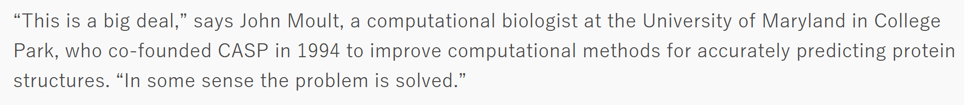
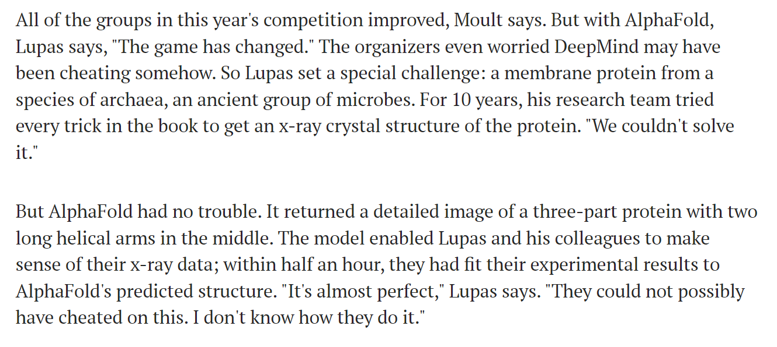
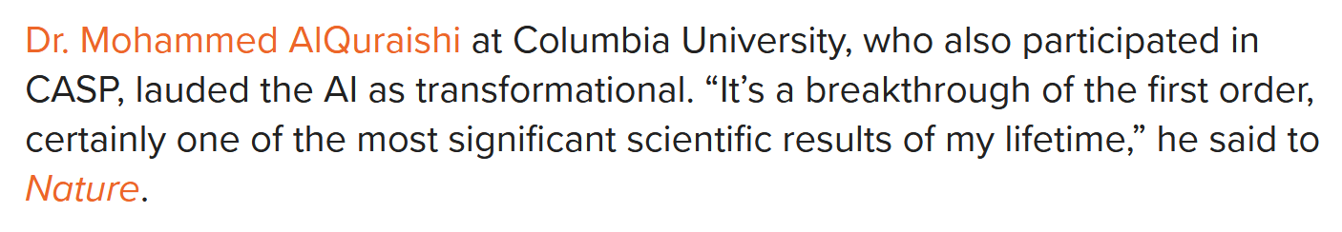
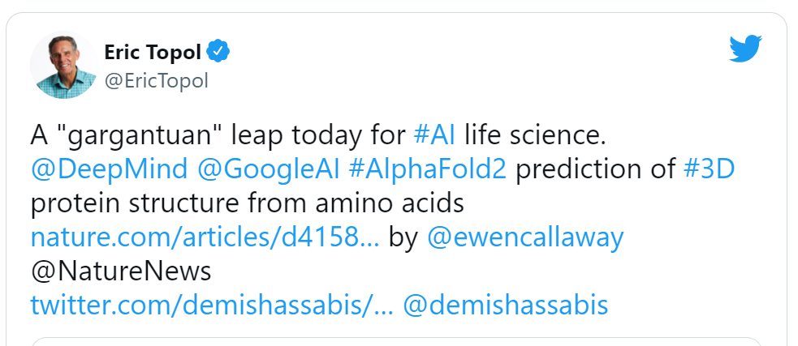
Reception of Alphafold 2

Slide 7
AlphaFold timeline
AlphaFold-Multimer available on HPC (UGent, GPU)
AlphaFold available on HPC (UGent, GPU)
2020
2021
2021
2022
Dec
Jan
Feb
Mar
Apr
May
Jun
Jul
Aug
Sep
Oct
Nov
Dec
Jan
Feb
Mar
Apr
AlphaFold (2.0) wins CASP14
AlphaFold multimer paper
AlphaFold v2.2.0 Multimer updated parameters
AlphaFold publication (Nature)
+ code+models
AlphaFold v2.1.0 multimer code+models
AlphaFold Protein Structure Database (with EMBL-EBI) released

Slide 8
The AlphaFold pipeline

Slide 9
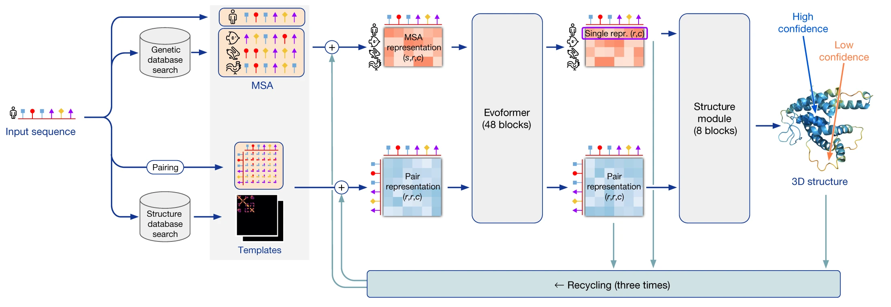
Stages of prediction
Amber
relaxation
Run inputs through 5 trained AlphaFold models (GPU)
5 structures predicted
sorted on confidence
Relax all 5 structures (Amber)
Multiple sequence alignment (CPU)
Structural templates search

Slide 10
AlphaFold training
5 prediction models
Trained for
Frame-aligned point error (FAPE)
Minimize distance between predicted structure and ground truth
+ auxiliary losses (predict confidence by estimating when mistakes are made, physical constraints, …)
Trained on
PDB protein fragments (256-384 residues)

Slide 11

Access to AlphaFold predictions
Memory (RAM)
GPUs
Huge databases (~2.2 TB)

Slide 12





AlphaFold availability
1.
2.
3.
Colabfold

Slide 13
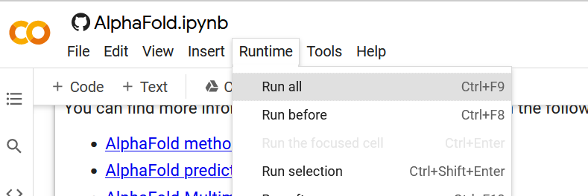
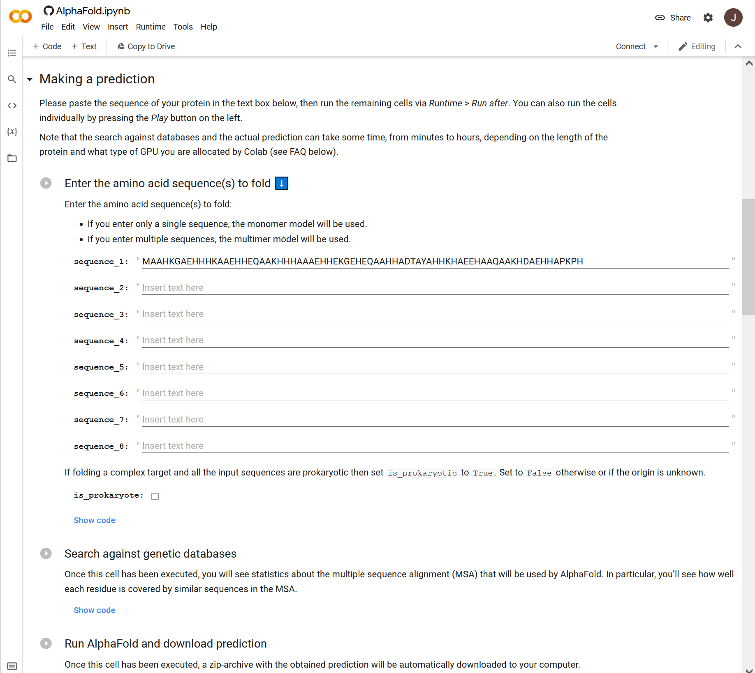
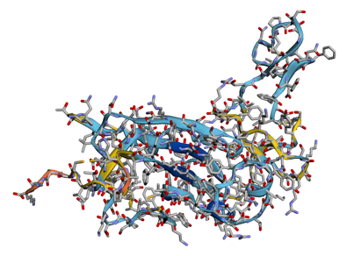
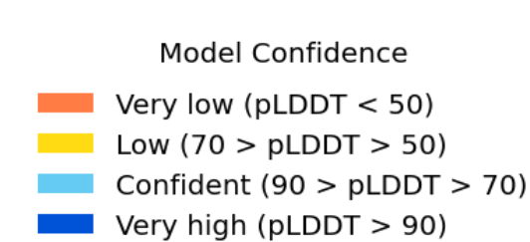
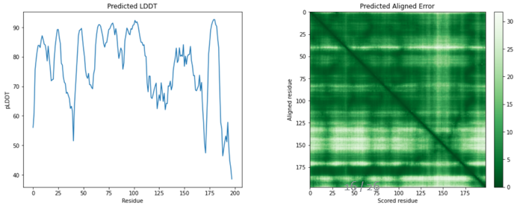
AlphaFold: Official Google Colab
3.
1.
4. Wait.
5.
2.
https://colab.research.google.com/github/deepmind/alphafold/blob/main/notebooks/AlphaFold.ipynb

Slide 14
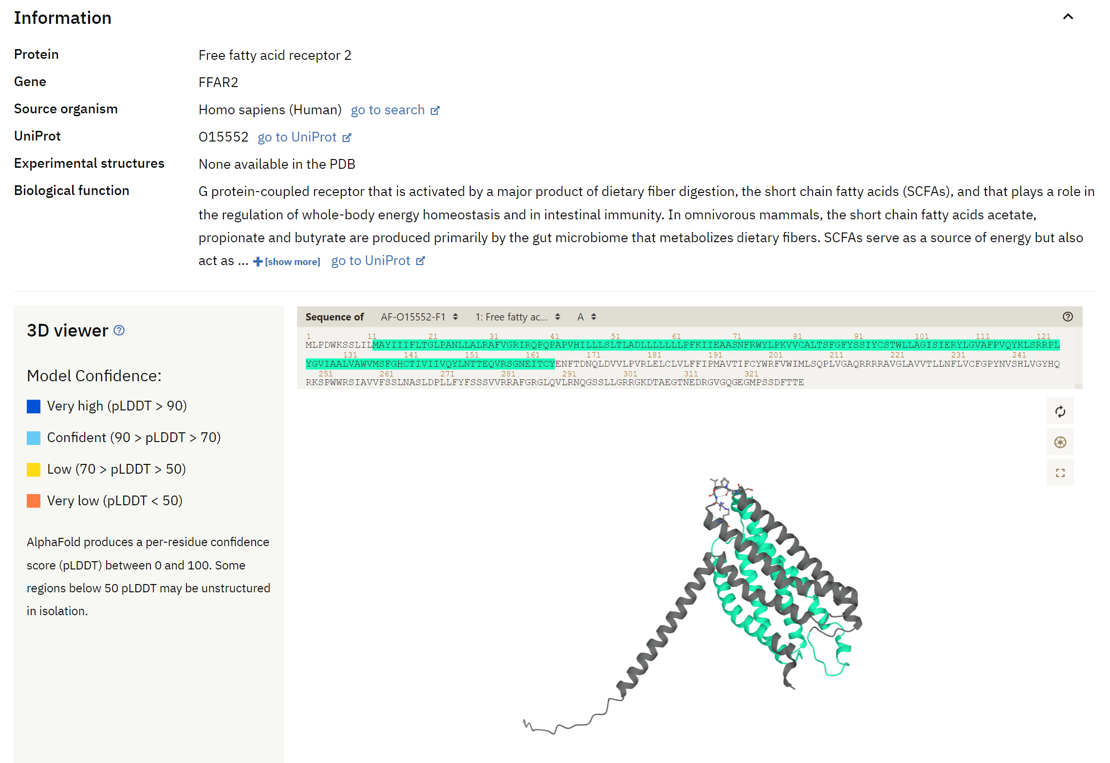
AlphaFoldDB (alphafold.ebi.ac.uk)
Predicted monomer structures
Coverage:
Swiss-Prot
48 complete proteomes (bulk download available)
16 < length < 2700
Currently 992,316 structures in total
! No multimers !

Slide 15

High-Performance Computing (HPC)
Software and databases
installed
State-of-the-art GPU/CPU/RAM hardware
Expert support
Queuing system for allocating resources

Slide 16
AlphaFold on HPC
Advantages:
Set up a large batches of experiments
Faster + GPUs have greater memory → longer sequences
No restricted availability (←→ Google Colab)
Available GPU servers (UGent):
Available GPUs KUL: 20 x 4 P100 (16GB) + 2 x 4 V100 (32GB)
Available GPUs UA: 2 x 2 P100 (16GB)
Available GPUs VUB: 6 x 2 K20Xm (6GB) + 4 x P100 (16GB) + 6 x A100 (40GB)
Available | joltik | 10 nodes | 4x V100 GPU per node (32GB) | 256 GiB RAM p/n | 800GB SSD p/n
Available | accelgor | 9 nodes | 4x A100 GPU per node (80GB) | ~500 GiB RAM p/n | 800GB SSD p/n
Tier 2

Slide 17
Computation time on the HPC (accelgor)

Slide 18
Online Google Colab limits
Google Colab

Slide 19
Running AlphaFold on the HPC

Slide 20
Set-up: requirements
https://docs.vscentrum.be/en/latest/access/getting_access.html
(account set-up should have been done in advance)
VSC account
Public/private key pair
Command line introduction:
https://elearning.bits.vib.be/courses/alphafold/lessons/alphafold-on-the-hpc/topic/basic-unix-commands/

Slide 21
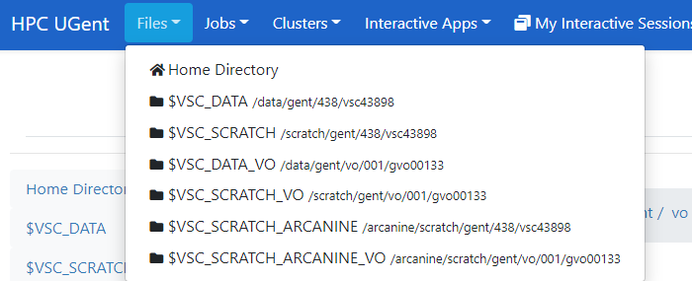




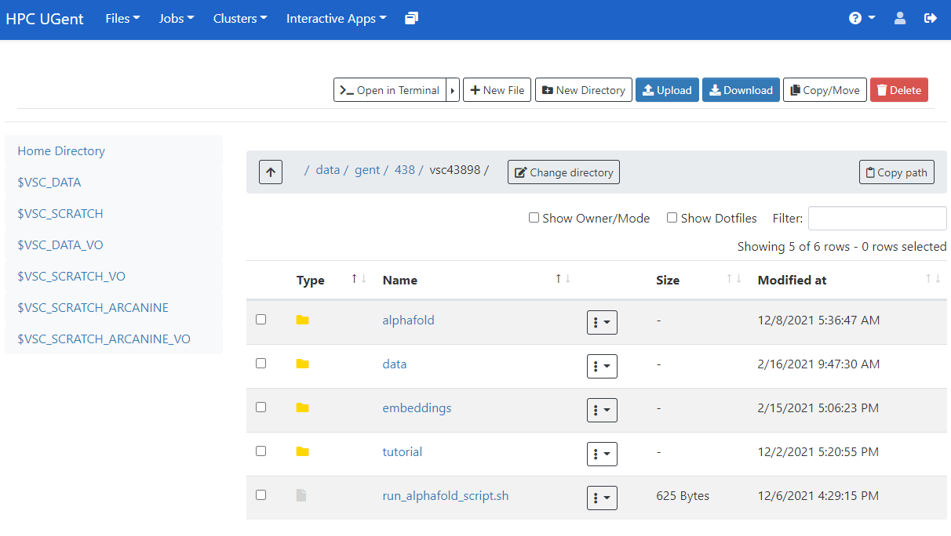
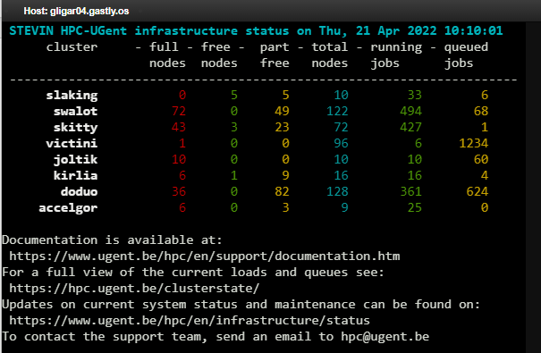
Set-up: logging in
login.hpc.ugent.be
transfer files
launch scripts

Slide 22
Set-up: directories and files
https://elearning.bits.vib.be/courses/alphafold/lessons/alphafold-on-the-hpc/topic/prepare-directories-and-files/
Default location when logging in
(~6GB)
Extra storage capacity
(~25GB)
When in a ‘virtual organization’
(~26TB shared)

Slide 23
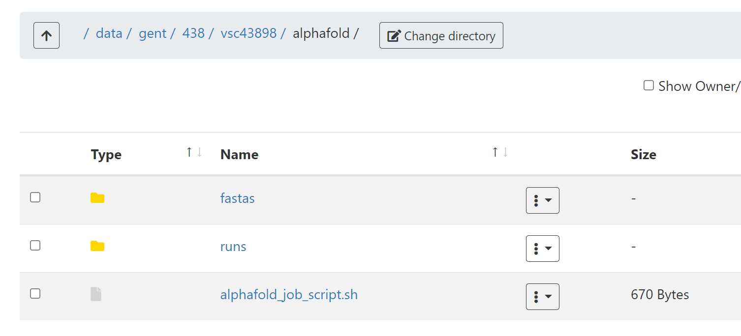
Set-up: directories and files
In $DATA_VSC: create directory alphafold
There:
Create directory fastas
Create directory runs
Download alphafold_job_script.sh
OR copy contents to a file,
OR right-click on Raw > Save link as,
OR use wget with the raw link (Raw > Copy link) on the command line directly
OR use mkdir on the command line,
OR use New directory on the web interface

Slide 24
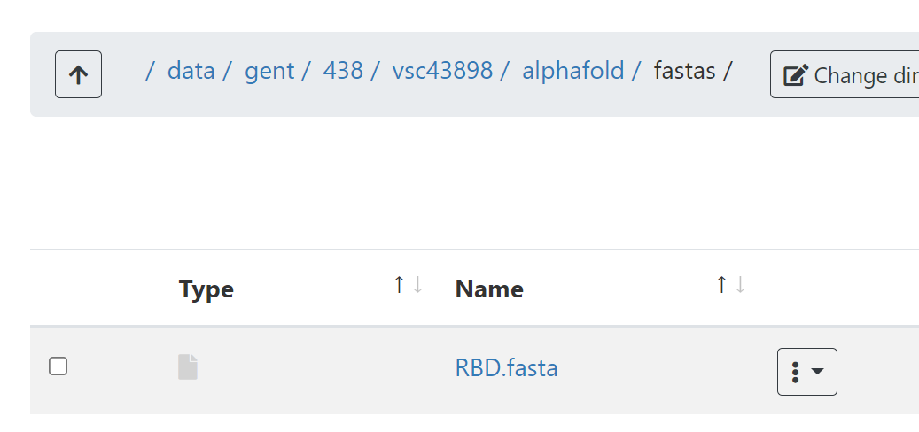
Set-up: directories and files
In fastas: create/upload your FASTA file
OR via command line (nano, vim, …)
OR by uploading an existing file to the web interface
OR by creating + editing a new file via the web interface

Slide 25
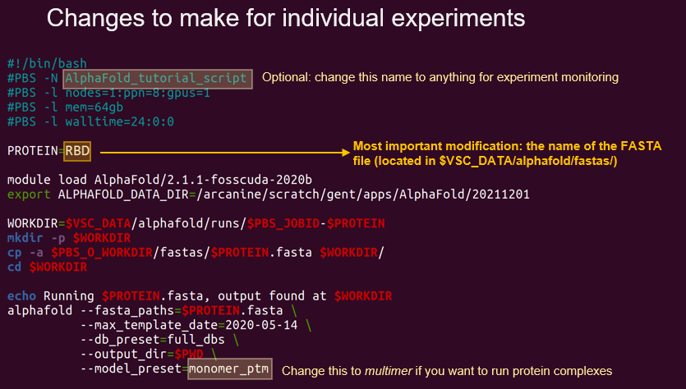
Set-up: modify alphafold_job_script.sh
https://elearning.bits.vib.be/courses/alphafold/lessons/alphafold-on-the-hpc/topic/setting-up-the-job-script/
download link

Slide 26
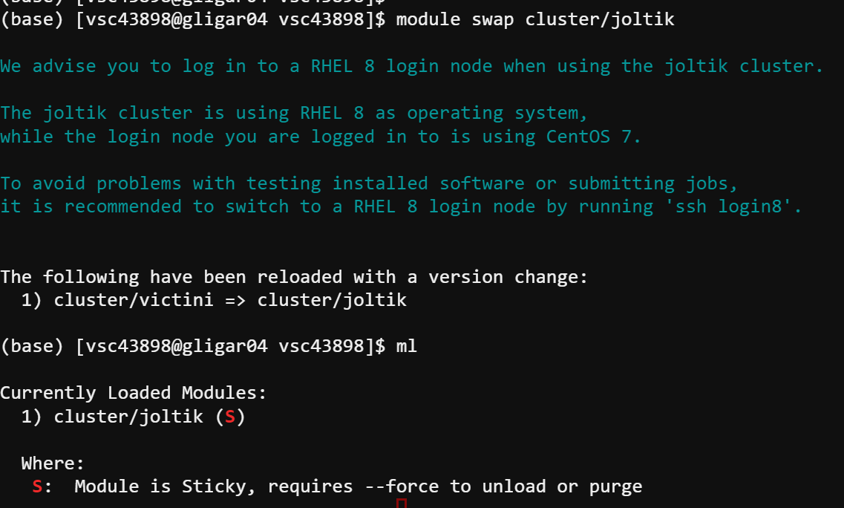
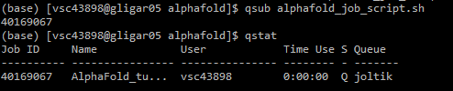
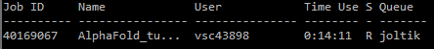
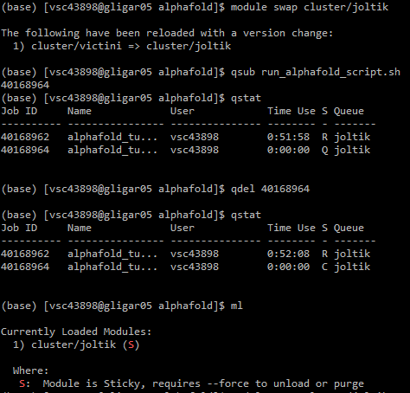
Set-up: submitting and monitoring
Necessary step: select the appropriate cluster (joltik in this case)
you can check it using ml
!! During this session only:
priority access to joltik via
qsub alphafold_job_script.sh --pass=reservation=alphafold
After setting up the cluster and the files, submit your job!
Check status
To cancel runs: use qdel

Slide 27
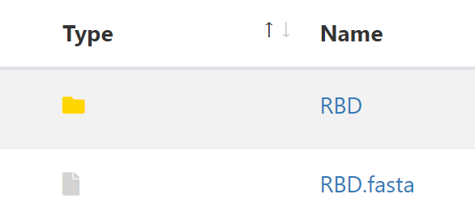
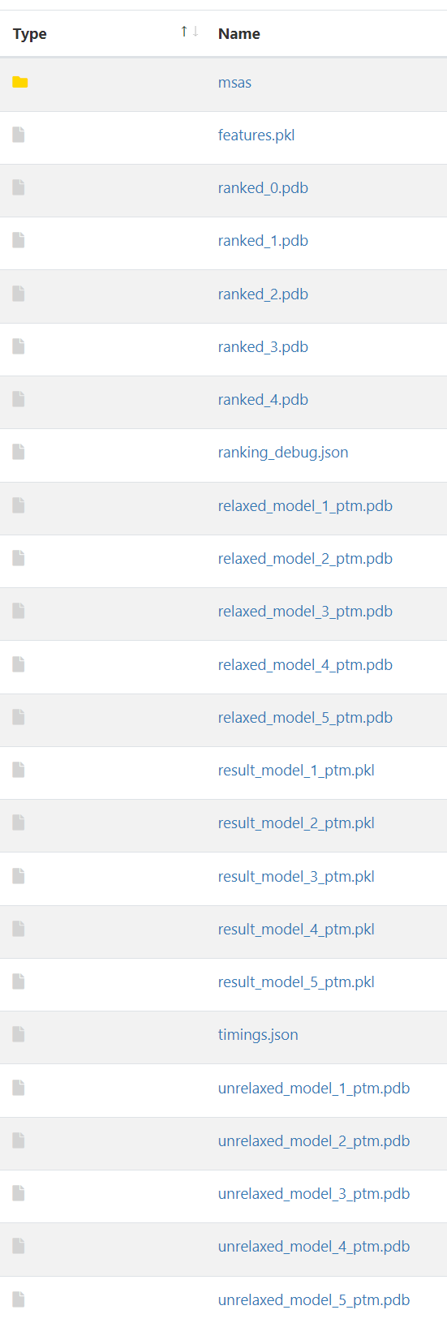
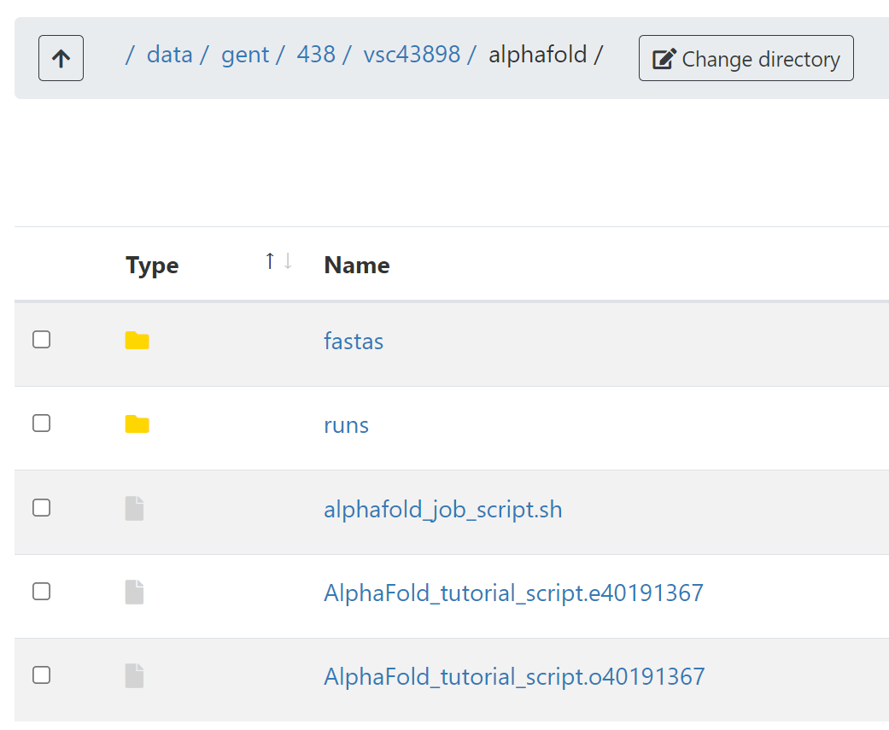
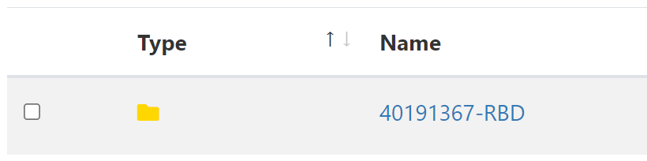
Monitoring + outputs
error file: tells when something goes wrong
output file: tells where output files are located
Troubleshooting:
https://elearning.bits.vib.be/courses/alphafold/lessons/alphafold-on-the-hpc/topic/troubleshooting/

Slide 28
Exercise: run a prediction on the HPC https://elearning.bits.vib.be/courses/alphafold/lessons/vib-training-session-alphafold/topic/first-experiment-on-the-hpc/

Slide 29
AlphaFold outputs

Slide 30
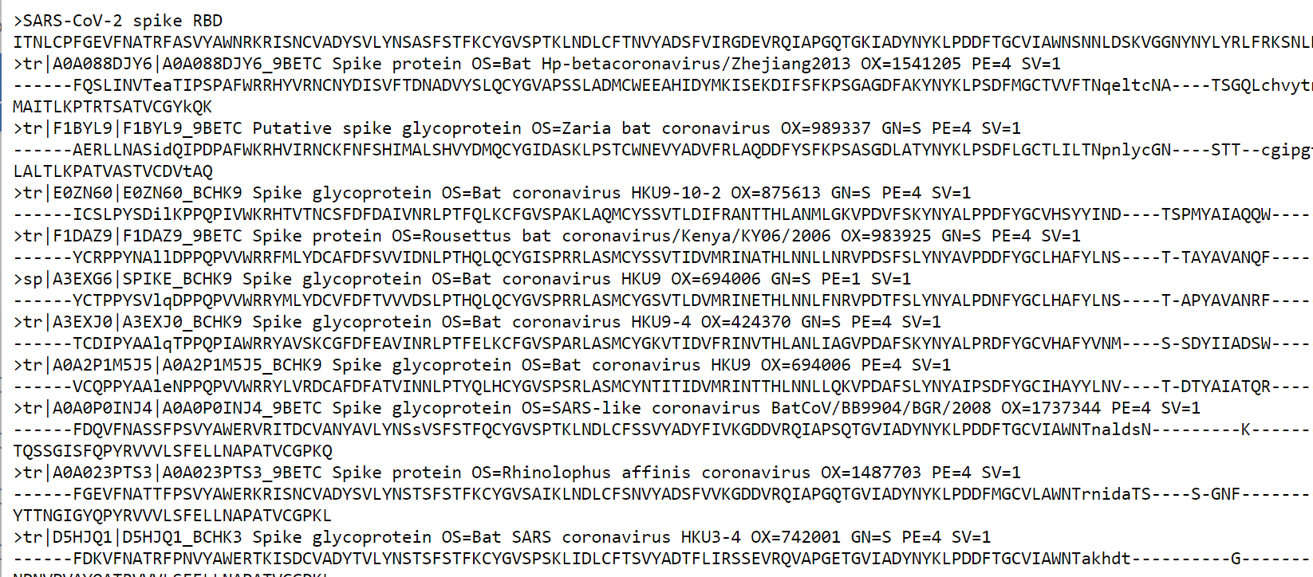
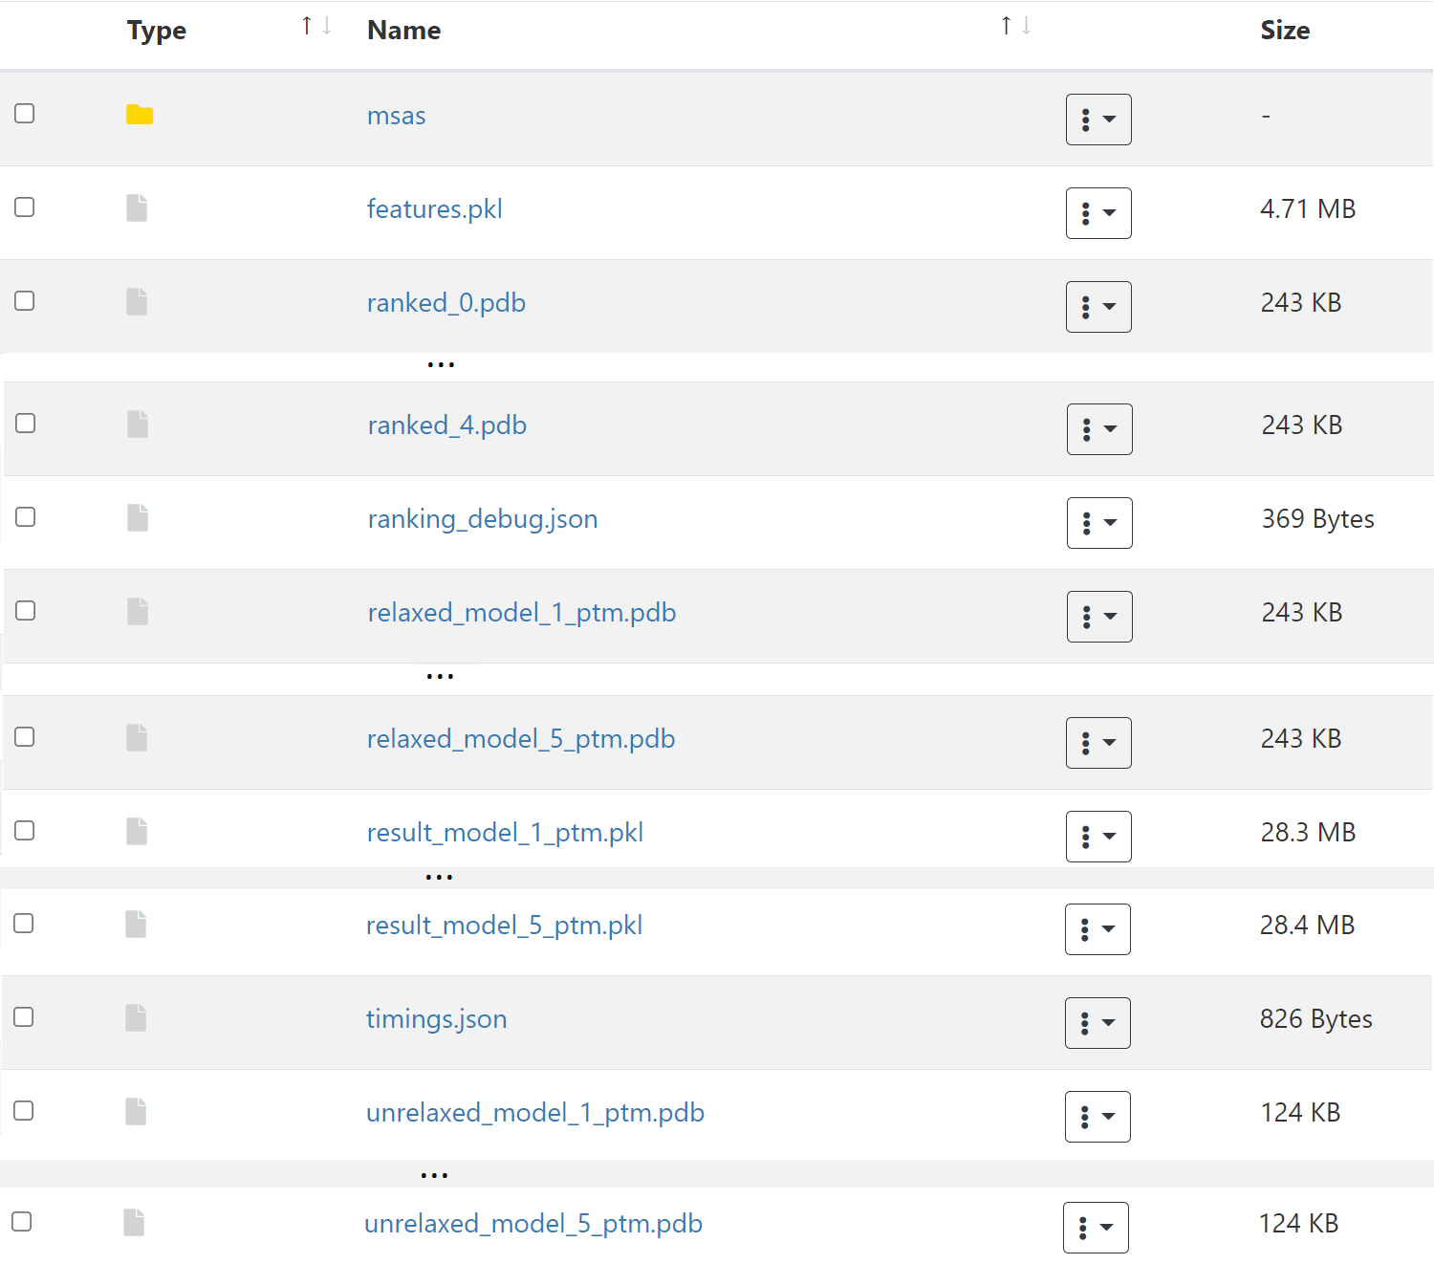
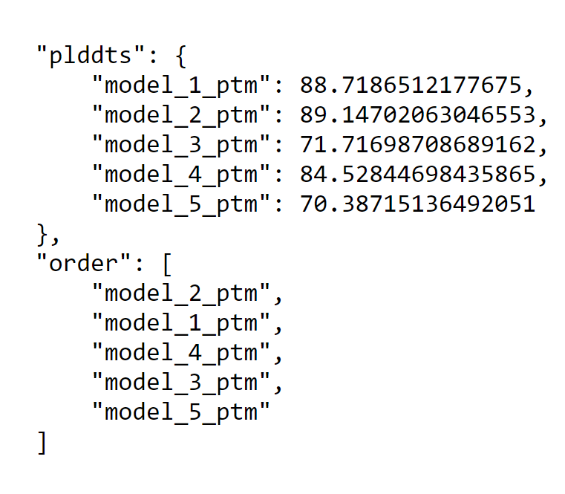
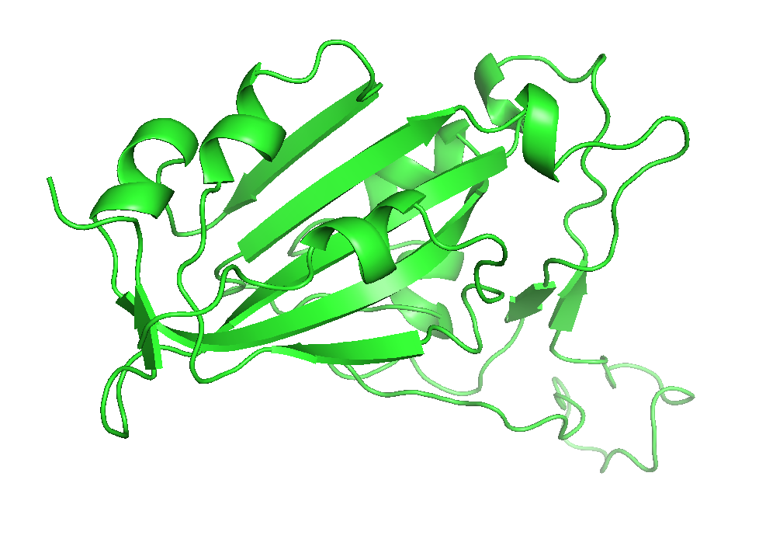
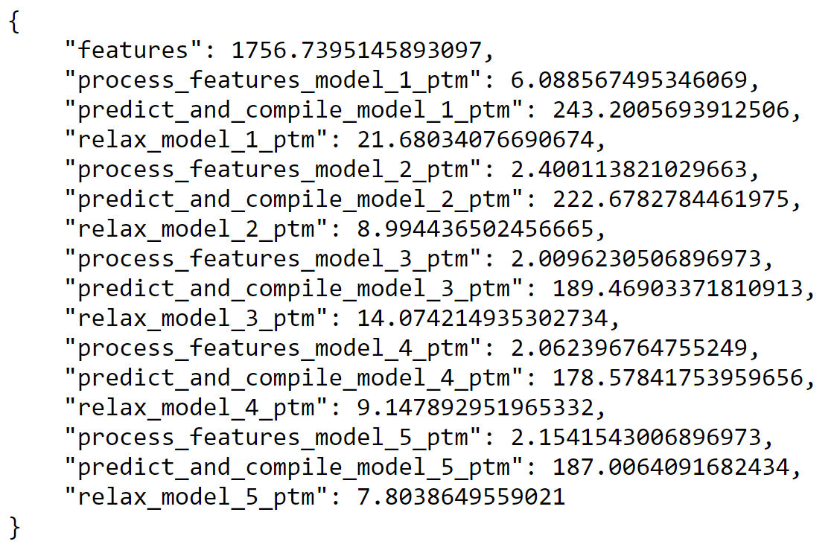
AlphaFold output folder
Actual input given to the predictor (after MSA)
.pkl = specific python data format
Extra output information (including confidence)
.pkl = specific python data format
! More later !

Slide 31
AlphaFold output folder

Slide 32
Evaluating & interpreting AlphaFold predictions

Slide 33
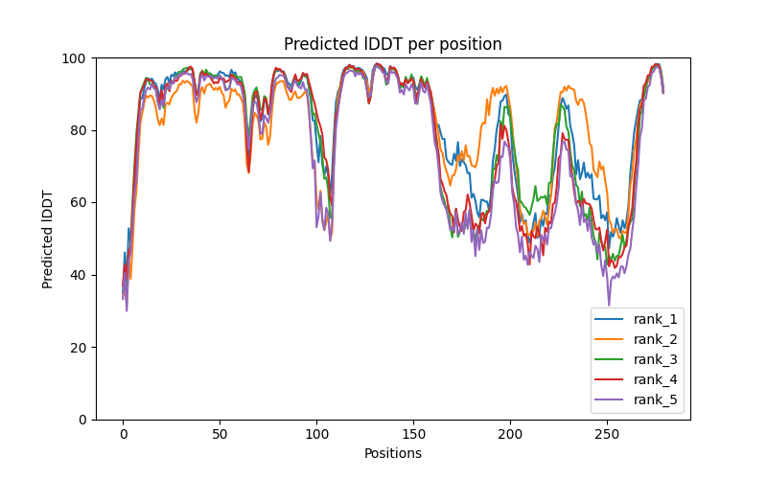
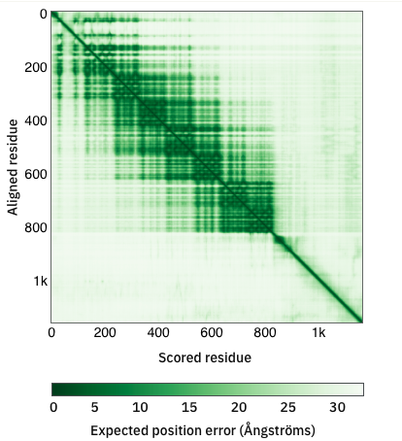
Metrics and scores to evaluate model accuracy
pTM: predicted TM-score
- global accuracy metric (score between 0 and 1)
pLDDT: predicted local distance difference test
- local (per residue) confidence metric
PAE: predicted alignment error
- assesses interdomain accuracy in multidomain proteins
- evaluation of protein-protein complexes
pLDDT plot
PAE plot

Slide 34
pTM-score: intrinsic model accuracy estimate
TM-score indicates the similarity between two structures by a score between 0 and 1, where 1 indicates a perfect match between two structures
The TM-score is intended as a more accurate measure of the global similarity of full-length protein structures than the often used RMSD measure (independent of protein length, less sensitive to local dissimilarity).
pTM score is the predicted TM-score between the structural prediction and the (unknown) true structure
Alphafold predictions (typically 5) are ranked based on the pTM score
References:
TM-score: Zhang Y and Skolnick J (2004). "Scoring function for automated assessment of protein structure template quality". Proteins
pTM score: Jumper et al., (2021). “Highly accurate protein structure prediction with AlphaFold”. Nature

Slide 35
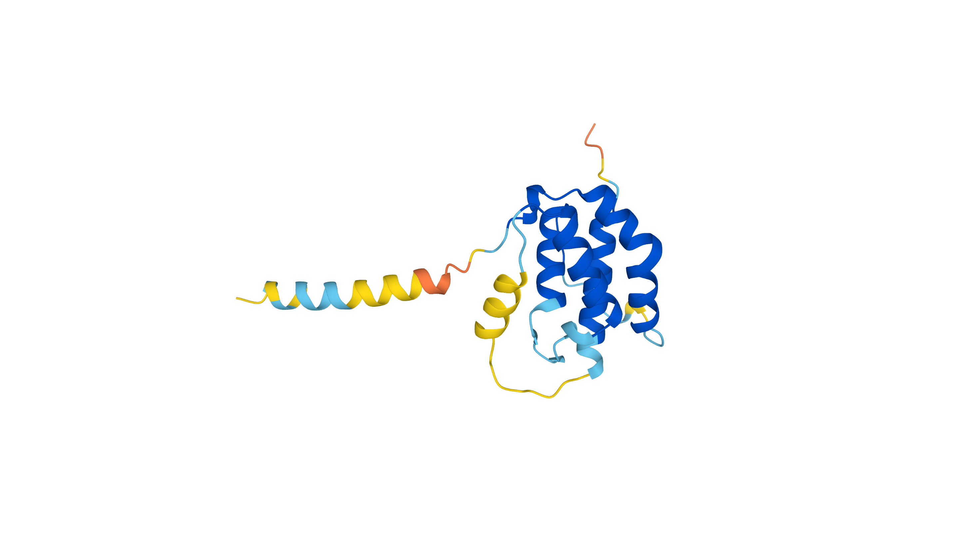

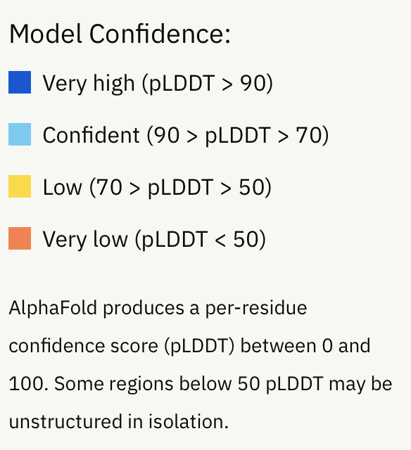
pLDDT-score reflects local model accuracy
pLDDT: predicted local distance difference test
per residue confidence metric
Estimates agreement of local environment between true structure and prediction
structural models are coloured according to the pLDDT-metric (relative scale 1- 100):
Structural model for Human TSLP
4-helix bundle region
(high-confidence)
Signal sequence
Loop region
(low-confidence)
21
Notes:
How to asses to quality of the structural models?
predictions: predicted local distance difference test (pLDDT)
- pLDDT provides a per-residue condidence metric
- pLDDT provides an estimate for each residues on how well the local environment around each residue (mainchain + side chain conformations) matches the true (unknown) structure
- relative scale 1 – 100
- linear plot or colored-coded on structure (B-factor column in pdb file)
- low confidence regions are associated with disorder

Slide 36
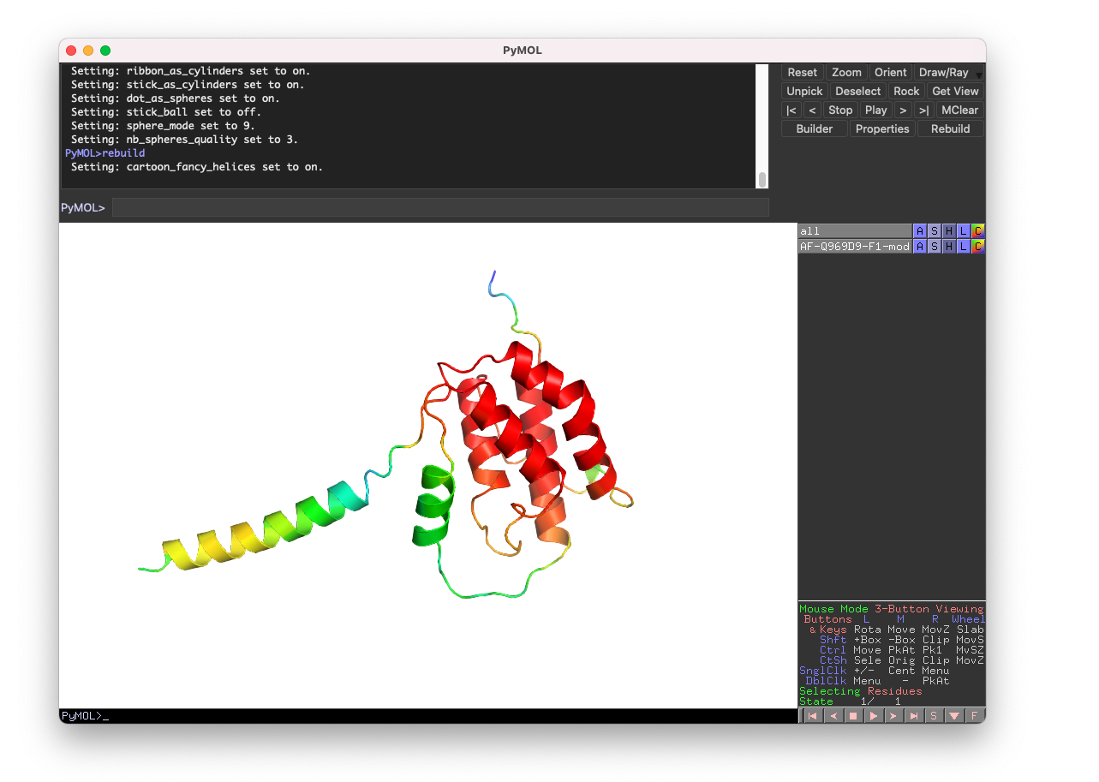
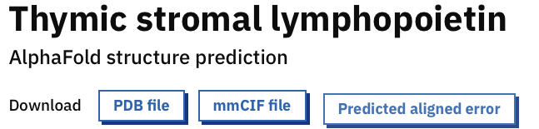

pLDDT-score reflects local model accuracy
PyMOL session window
Pdb file is opened with a molecular graphics programs such as Pymol, Chimera or Yasara
EDU VERSION available free of charge
(available on Mac, Windows, Linux)
AlphaFold model
colored by ‘B-factor’
Pdb file stores the coordinates and per-residue pLDDT-score
Model can easily be according to confidence level
Low confidence
High confidence
pLDDT score
22
Notes:
Pdb file contains coordinates
for the structural models
Later a small tutorial will follow (color model according to B-factor, pLDDT

Slide 37
pLDDT-score reflects local model accuracy
pLDDT plot

Slide 38
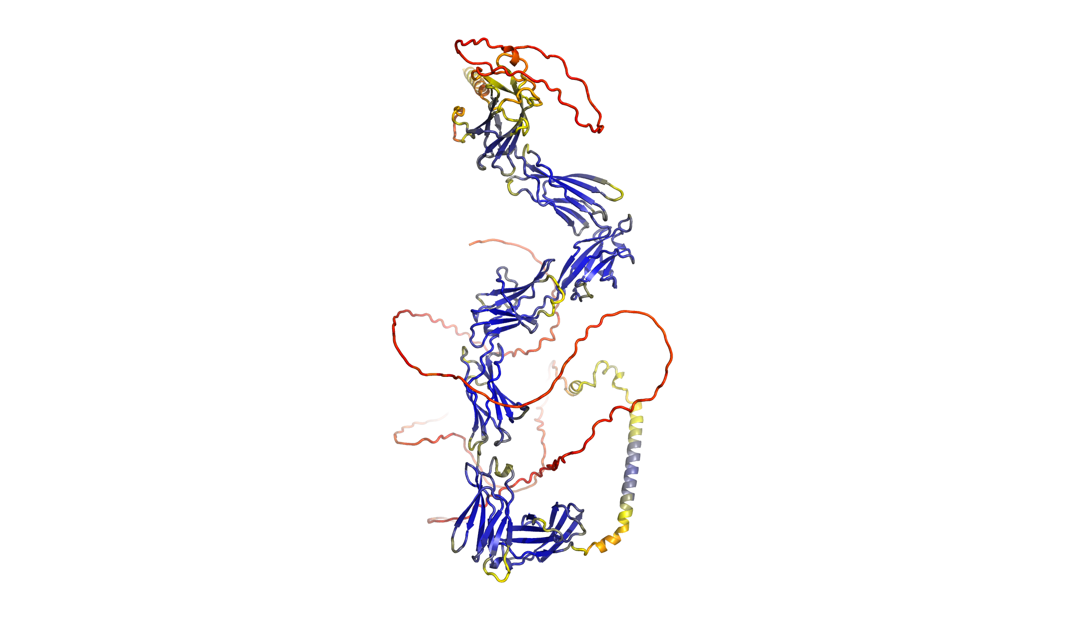
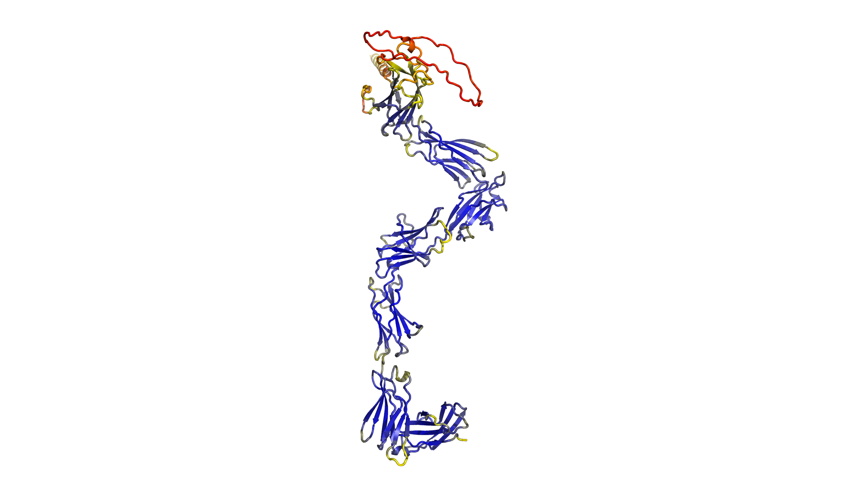
PAE-plot evaluates interdomain accuracy
N
pLDDT --> metric assesing local structural quality/confidence
Prediction for
human LEPR
D1
PAE metric --> Predicted aligned error assesses inter-domain accuracy
PAE plot shows predicted error between all pairs of residues
Extracellular region only
PAE plot
D1
D2
D2
very high
D3
D3
D4
D4
D5
pLDDT
Intracellular loops
D5-6
very low
D5
Intracellular region
TM-helix
D5-6
C
Alphafold models can be very informative to delineate domains / functional regions (construct design).
Notes:
AF is not aware of the
cellular environement

Slide 39
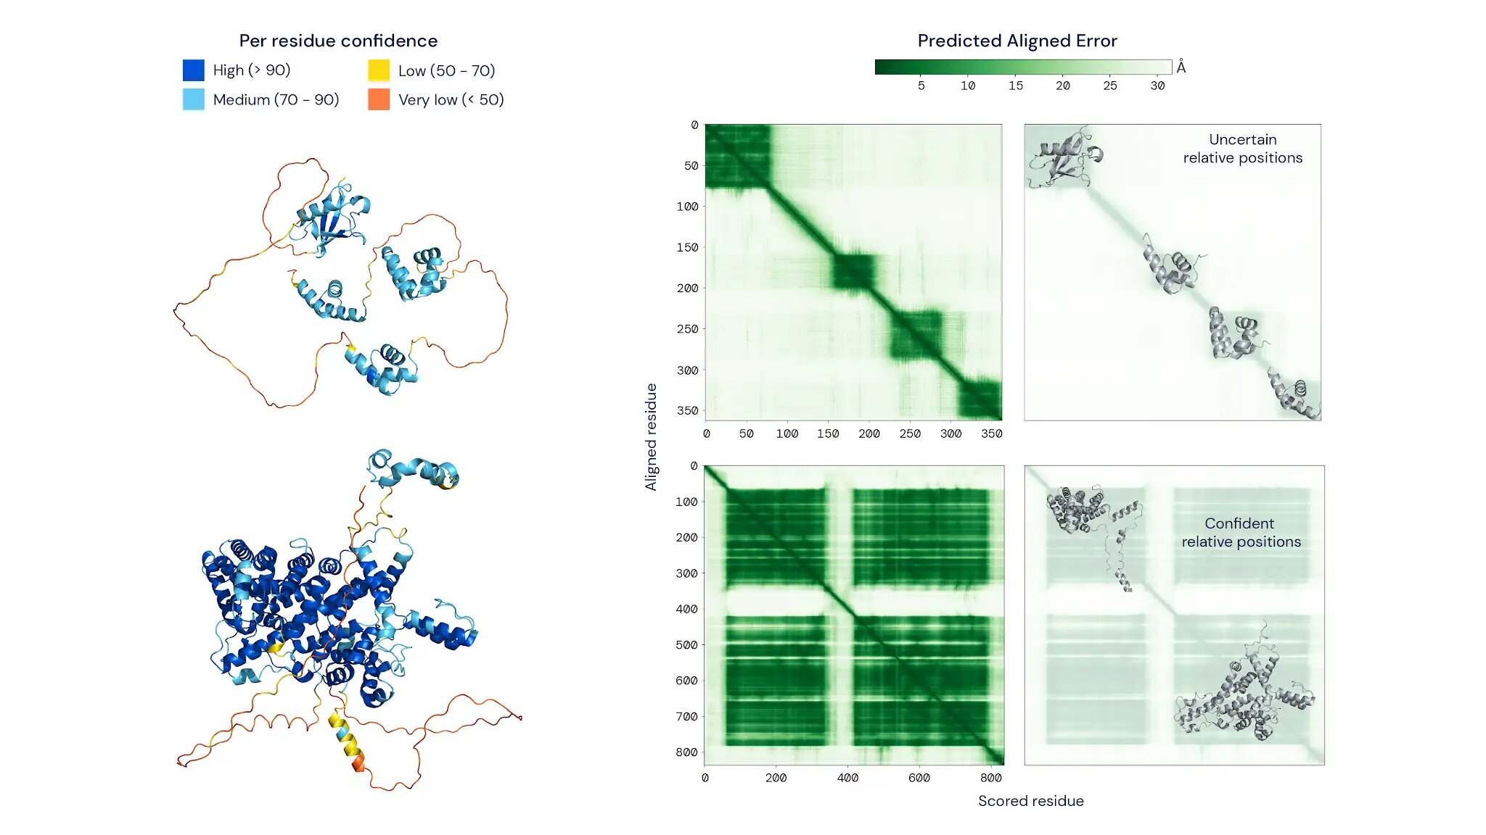
P54725
Q5VSL9
https://www.deepmind.com/
Notes:
https://www.deepmind.com/publications/enabling-high-accuracy-protein-structure-prediction-at-the-proteome-scale

Slide 40
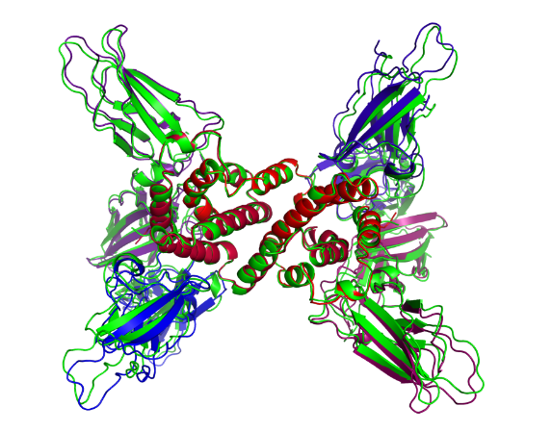
AlphaFold-Multimer: prediction of complexes
AlphaFold model trained specifically for multimeric protein complexes
Works relatively well
Successful prediction of interface in 70% of cases
High accuracy complex model in 26% of cases
Higher performance for homomeric interfaces than heteromeric interfaces
Evolutionary information is harder to access for heteromeric assemblies
Algorithm is (generally) not able to predict binding of antibodies/nanobodies
No evolutionary information available
A2B2C2 heteromer
Ground truth
Evans*, O’Neill*, Pritzel*, Antropova* et al., BioRxiv, 2022
41

Slide 41
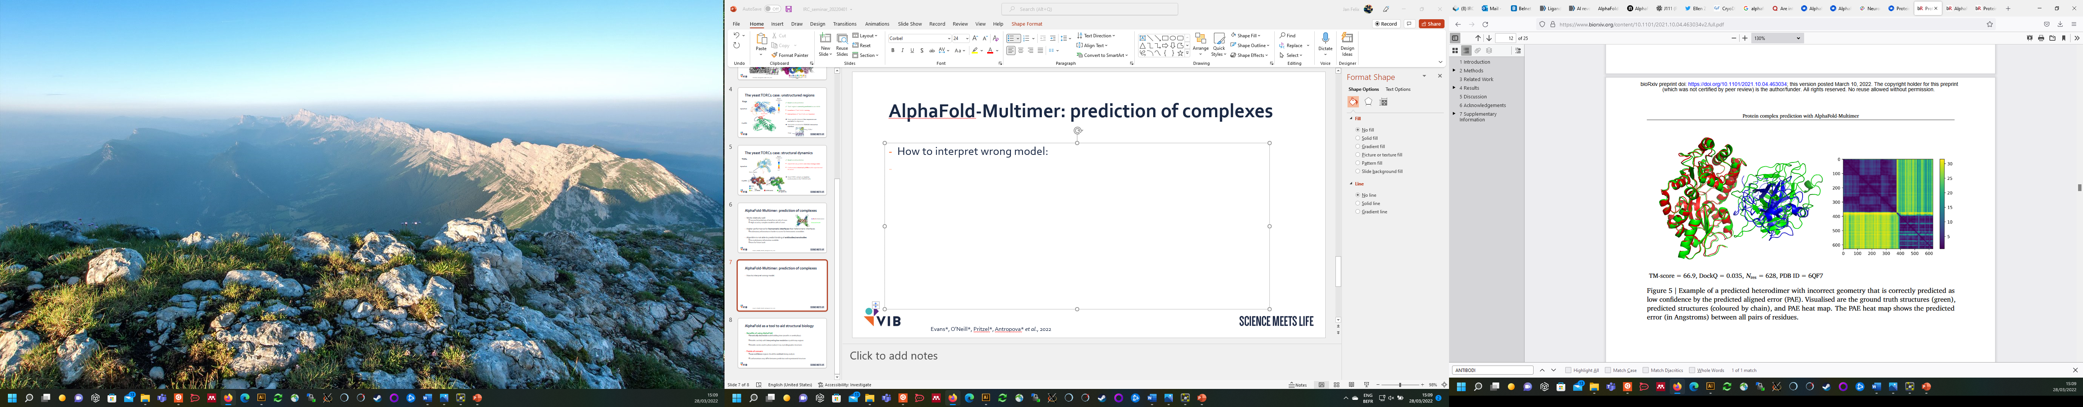
AlphaFold-Multimer: evaluation metrics
ipTM: interface pTM
scores the interactions between residues of different chains (protein interface)
a weighted combination of pTM and ipTM as our model confidence metric, in order to account for some intra-chain confidence in the model ranking: model confidence = 0.8 · ipTM + 0.2 · pTM
Evans*, O’Neill*, Pritzel*, Antropova* et al., BioRxiv, 2022
PAE plot
chain A
PAE plot
Predicted aligned error (PAE) shows the predicted error between all pairs of residues
Plot shows accurate predictions for the individual domains, but an inaccurate geometry of the predicted complex
chain A: residues 1-380
chain B: residues 381-620
chain B
A-B interface
42

Slide 42
Exercise: Using the interactive AlphaFoldDB interface
https://elearning.bits.vib.be/courses/alphafold/lessons/vib-training-session-alphafold/topic/analyze-the-prediction-for-usp7-on-alphafolddb/

Slide 43
Example use-case

Slide 44
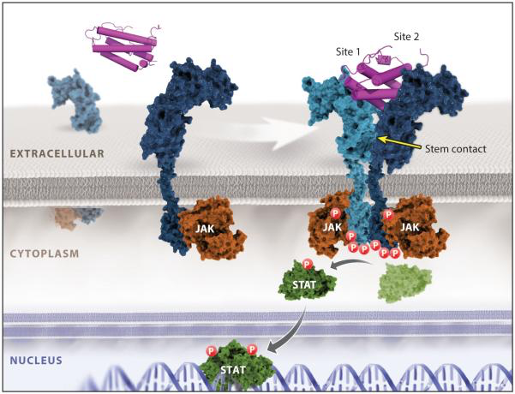
Prediction of a cytokine-receptor complex
Cytokine binding induces receptor dimerization and signaling
Spangler et al., Annu Rev Immunol, 2015

Slide 45




Prediction of the proinflammatory signaling complex mediated by human TSLP
Target proteins:
Human TSLP, Uniprot ID Q969D9, residues 29-159
(without signal peptide)
?
Extracellular assembly
Human TSLP-R ectodomain, Uniprot ID Q9HC73,
residues 23-231
Human IL-7R ectodomain, Uniprot ID P16871, residues 21-239

Slide 46
Input text file with sequences in fasta format
>hTSLP_sp|Q969D9|29-159
YDFTNCDFEKIKAAYLSTISKDLITYMSGTKSTEFNNTVSCSNRPHCLTEIQSLTFNPTA
GCASLAKEMFAMKTKAALAIWCPGYSETQINATQAMKKRRKRKVTTNKCLEQVSQLQGLW
RRFNRPLLKQQ
>hIL7Ra_sp|P16871|21-239
ESGYAQNGDLEDAELDDYSFSCYSQLEVNGSQHSLTCAFEDPDVNITNLEFEICGALVEV
KCLNFRKLQEIYFIETKKFLLIGKSNICVKVGEKSLTCKKIDLTTIVKPEAPFDLSVVYR
EGANDFVVTFNTSHLQKKYVKVLMHDVAYRQEKDENKWTHVNLSSTKLTLLQRKLQPAAM
YEIKVRSIPDHYFKGFWSEWSPSYYFRTPEINNSSGEMD
>hTSLPR_sp|Q9HC73|23-231
QGGAAEGVQIQIIYFNLETVQVTWNASKYSRTNLTFHYRFNGDEAYDQCTNYLLQEGHTS
GCLLDAEQRDDILYFSIRNGTHPVFTASRWMVYYLKPSSPKHVRFSWHQDAVTVTCSDLS
YGDLLYEVQYRSPFDTEWQSKQENTCNVTIEGLDAEKCYSFWVRVKAMEDVYGPDTYPSD
WSEVTCWQRGEIRDACAETPTPPKPKLSK

Slide 47



pLDDT plot indicates disordered regions
TLSP
IL-7Ra
TLSPR
Colored by pLDDT
Colored by chain
Low confidence
High confidence
C
N
N
C
C
TLSP
IL-7Ra
N
TLSPR

Slide 48
pLDDT plot indicates disordered regions
pLDDT-score (B factor column)
Open pdb file with text editor
ATOM 1 N TYR A 1 7.960 6.236 -30.112 1.00 95.23 N
ATOM 2 H TYR A 1 7.706 6.779 -29.299 1.00 95.23 H
ATOM 3 H2 TYR A 1 7.427 6.587 -30.895 1.00 95.23 H
ATOM 4 H3 TYR A 1 8.951 6.321 -30.287 1.00 95.23 H
ATOM 5 CA TYR A 1 7.596 4.833 -29.851 1.00 95.23 C
ATOM 6 HA TYR A 1 7.726 4.235 -30.753 1.00 95.23 H
ATOM 7 C TYR A 1 6.129 4.814 -29.477 1.00 95.23 C
ATOM 8 CB TYR A 1 8.472 4.249 -28.737 1.00 95.23 C
ATOM 9 HB2 TYR A 1 9.497 4.189 -29.103 1.00 95.23 H
ATOM 10 HB3 TYR A 1 8.460 4.920 -27.879 1.00 95.23 H
ATOM 11 O TYR A 1 5.713 5.734 -28.785 1.00 95.23 O
ATOM 12 CG TYR A 1 8.043 2.871 -28.291 1.00 95.23 C
ATOM 13 CD1 TYR A 1 7.295 2.723 -27.108 1.00 95.23 C
ATOM 14 HD1 TYR A 1 7.036 3.582 -26.508 1.00 95.23 H

Slide 49

PAE plots indicates an accurate protein complex geometry

Slide 50

PAE plots indicates an accurate protein complex geometry
TLSP
TLSP
IL-7Ra
TLSPR
IL-7Ra
TLSPR
TLSP
IL-7Ra
TLSPR

Slide 51



Comparison with experimental crystal structure?
Crystal packing of TSLP:TSLPR:IL7-R complexes
Notes:
On the left you can see a picture of a protein crystal. A protein crystal consists of a an ordered 3-dimensional array of protein molecules that are thightly packed together. To facilitate the formation of high quality crystalline lattices a highly pure protein preparation is needed.

Slide 52


Comparison with experimental crystal structure?
Experimental crystal structure to 2.56 Å resolution (pdb 5j11)
Alphafold-Multimer prediction
Notes:
Executive: RMSD = 0.586 (452 to 452 atoms)

Slide 53

Comparison with experimental crystal structure?
Rmsd-value =
0.59 Å for 452 aligned Cα atoms

Slide 54
Pitfalls of AlphaFold

Slide 55
AlphaFold: uncertainties and potential pitfalls
Only prediction of proteins and protein complexes (no nucleic acids)
Low accuracy of regions where few sequences are available for alignment
Low accuracy of intrinsically unstructured regions
Limited information on structural dynamics
Varying accuracy of multimeric assemblies
No information on co-factors/ligands/post-translational modifications
No post-translational processing, no compartmentalization of transmembrane assemblies

Slide 56

AlphaFill: filling models with ligands/co-factors
Algorithm based on sequence and structure similarity
AlphaFold sequence is BLASTed against database with experimental structures (PDB)
Adding missing small molecules/ions from experimentally determined structures to AlphaFold models
BLAST hits are checked for compounds of interest and filtered for homology
Hits are structurally aligned with AlphaFold models
Compounds are integrated into AlphaFold models
Hekkelman*, de Vries* et al., BioRxiv, 2022
43

Slide 57

AlphaFill: filling models with ligands/co-factors
Sodium ion
Retinal
Hekkelman*, de Vries* et al., BioRxiv, 2022
44

Slide 58

AlphaFill: filling models with ligands/co-factors
Human myoglobin
‘transplanted’ Heme group
Hekkelman*, de Vries* et al., BioRxiv, 2022
45

Slide 59
Exercise: Set up Multimer prediction
https://elearning.bits.vib.be/courses/alphafold/lessons/vib-training-session-alphafold/topic/run-alphafold-multimer/

Slide 60
Exercise: Generate PAE/PLDDT using python script
https://elearning.bits.vib.be/courses/alphafold/lessons/vib-training-session-alphafold/topic/generate-pae-plddt-plots/

Slide 61
Exercise: Align & analyze predictions for SarsCov1 - VHH72 complex
https://elearning.bits.vib.be/courses/alphafold/lessons/vib-training-session-alphafold/topic/analyze-the-predicted-sarscov1-vhh72-complex/

Slide 62

Acknowledgements
Jasper Zuallaert
Kenneth Verstraete
Alexander Botzki
Janick Mathys
Kenneth Hoste

